Slide 1
Strategic Planning
Module 6 - Part 2
Internal Analysis of the Company
Instructor: Moataz Darwish, MBA

Slide 2
Contents
6.1 Opportunity Cost 6/3
6.2 Fixed Costs, Variable Costs and Sunk Costs 6/4
6.3 Marginal Analysis 6/5
6.4 Diminishing Marginal Product 6/8
6.5 Profit Maximisation 6/10
6.6 Estimating Production Costs 6/10
6.7 Accounting Techniques: Break Even, Payback and Sensitivity 6/13
6.8 Accounting Ratios 6/17
6.9 Benchmarking 6/22
6.10 Research and Development 6/23
6.11 Human Resource Management 6/29
6.12 The Scope of the Company 6/31
6.13 The Value Chain 6/40
6.14 Competence 6/43
6.15 Strategic Architecture 6/49
6.16 Strategic Advantage Profile 6/54
EBS MBA / AUC

Slide 3
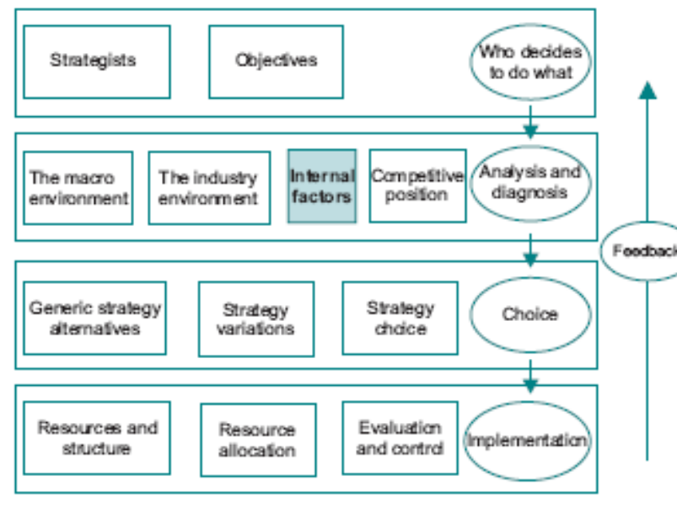
The Model
EBS MBA / AUC

Slide 4
Resource Management
Management of resources has a direct bearing on the competitive position of the company;
How can the company rationalize resource planning and allocation?
    Identify the company’s approach to resource planning.
    REACTIVE
      look one period ahead and hires and fires accordingly
    PROACTIVE
      product life cycles
      product launch periods
      selecting a planning horizon (beyond which so little is known)
      developing a resource plan (incl inventories, learning curves..)
      the implications for marketing strategy
EBS MBA / AUC

Slide 5
Human Resource Management
Effective human resource management is important for strategy for two reasons:
  people in a company are a resource like any other and how effectively that resource operates can be affected by strategic change.
  strategic changes are introduced and implemented by people, and resistance to change can exert a powerful constraint on success.
Adaptability and the ability to cope with strategic change is a major
objective of human resource management.
EBS MBA / AUC

Slide 6
Human Resource Management
One of the main characteristics of an organization is its culture.
  Culture is the set of beliefs, values and managerial approaches;
  Reflected in its structures, systems and approach to the development of strategy.
  Derived from the company’s past history, type of leadership, the people involved, its use of technology and resources.
  Culture of each company is likely to be unique.
EBS MBA / AUC

Slide 7
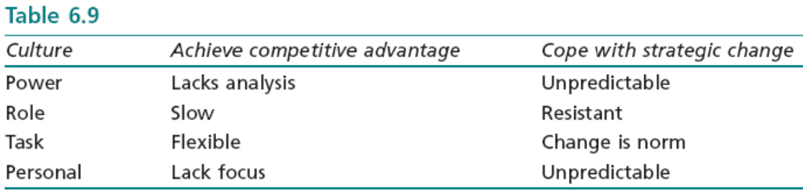
Human Resource Management
Four broad types of culture – classification helps in understanding how the workforce is likely to react to strategic change:
  Power Culture - revolve around one individual (or small group),who dominates decision making, usually to new or small co. (newspaper industry).
  Role Culture - relies on committees, structures, analysis and the application of logic. While a small group of senior managers make final decisions, they rely on procedures and systems and clearly defined rules of communication. This bureaucratic type of structure works well when the environment is stable. (civil service and the old style retail banks).
  Task Culture - in organizations which are geared to tackle specific tasks which tend to be of limited duration. Uses the team approach (advertising agencies and consultancies).
  Personal Culture - individual pays little attention to the organization and is most concerned with self gratification. (Voluntary Workers)
What might appear to be a cultural problem may in fact be due to the more general principal agent problem, ex. the incentive system.
EBS MBA / AUC

Slide 8
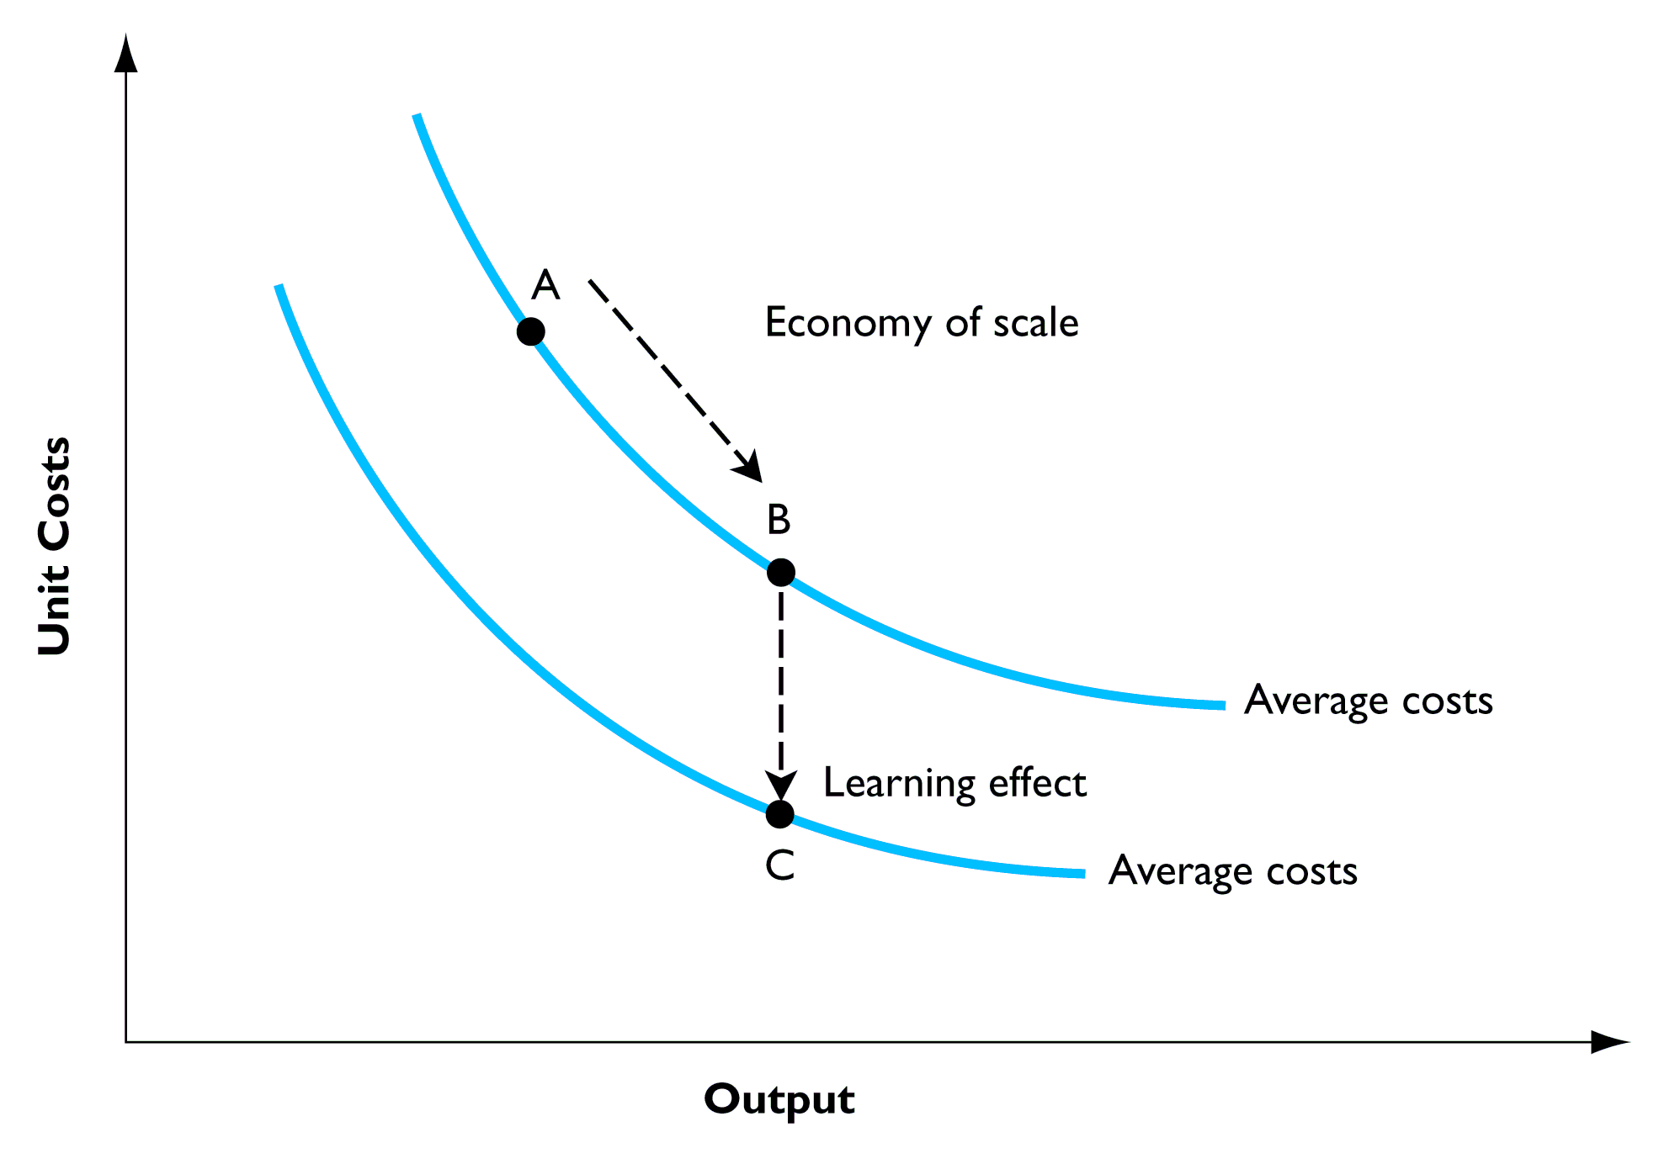
Reduction in unit cost due to
The scope of the company
Economies of Scale
Economies of Scope
Experience Curve
(Economies of Learning)
  High scale of ops
  “no. of units produced”
  Entry Barrier
  close to synergy
  “no. of products”
  Reputation, shared I/P,
  R&D spillover…
  Output to-date
EBS MBA / AUC
Notes:
Other cost efficiencies: supply cost and product design.

Slide 9
Economies of Scale and the Experience Curve
Economies of Scale - important as an entry barrier;
Average cost of production in relation to the productive capacity of a company.
In some industries it is significant, and in others it hardly exists.
It is not merely the increase in productive capacity which is relevant, but whether the higher productive capacity is based on a more efficient combination of labor and capital.
  It may be that some larger companies have not selected the optimum combination of inputs.
  Difficulties of managerial coordination beyond some company size make it impossible to benefit from potential scale economies.
    In 1995 two very large Japanese banks, no job losses as a result of the merger.
Economies of scale tend to be confused with the experience curve.
EBS MBA / AUC

Slide 10
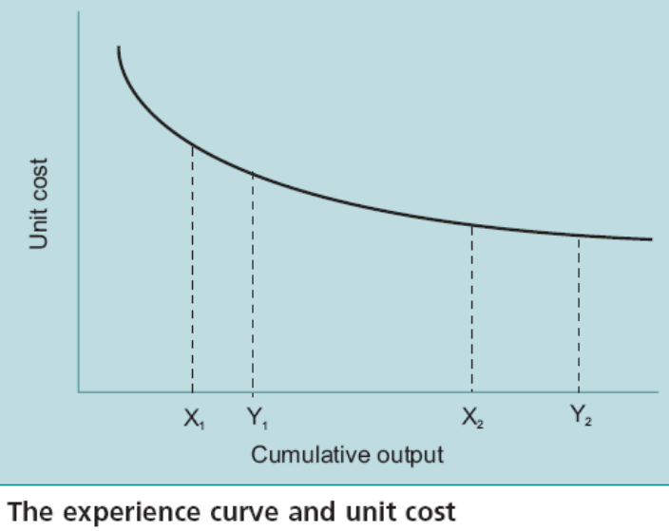
Economies of Scale and the Experience Curve
Experience Curve, relates to the reduction in average costs resulting from the total volume of output to date.
  ex. degree to which employees learn to do their job more efficiently over time.
  effect of experience varies among companies and industries;
  Empirical evidence: doubling of output has the potential to lead to a 20% reduction in average cost.
  Not linear: i.e. it takes successive doubling of output to achieve the same proportional cost reduction.
The advantage conferred by experience is continually being eroded.
EBS MBA / AUC

Slide 11
Economies of Scale and the Experience Curve
Strategic Implication:
  A company which feels it has a cost advantage over rivals should attempt to identify where the advantage is derived.
    If it is from experience effects, the advantage can be expected to decline over time;
    If it is from economies of scale the advantage will be retained so long as competing companies do not increase in size.
EBS MBA / AUC

Slide 12
Economies of Scope
Economies of scope: reduction in unit cost as the number of products is increased rather than the number of units produced.
Resemblance to synergy,
Why it may be cheaper to produce two goods than for two firms to do so:
  possibility of sharing inputs among several outputs: Sainsbury’s sells about 30 000 items – because below some critical number customers do not find it worthwhile to come in.
  benefits of good reputation: Rolls Royce cars carries over to its aero- engines.
  R&D spillover effects
  enhanced ability to compete in a range of related industries with a coordinated strategy – though diseconomies of scope may result as scarce management skills are spread ever more thinly especially in unrelated markets.
EBS MBA / AUC

Slide 13
Diversification
Firms need to confront the issue of the optimal degree of diversification.
Porter tracked the performance of 32 firms which were involved in acquisitions, and concluded that there had been virtually no benefit in any of the cases.
Four main incentives to diversify:
  Minimize risk - Management risk not Shareholder risk!
  Capture economies of scope – might lead to value destruction, spreading scarce top management skills across apparently unrelated business areas through the application of their dominant management logic (dangerous)
  Add value through the parenting function
  Benefit from synergy
    Richard Branson’s business empire ex: dominant management logic of Branson, brand stretching; (long term value is difficult to imagine).
EBS MBA / AUC

Slide 14
Synergy
The notion differs from economies of scale and experience in that it is independent of the size of the company, or of the total output to date.
Synergy should lead to the situation where a corporation is valued at more than the sum of the value of its individual parts if they could be separated. 2 + 2 = 5 effect;
While the idea of synergy has an intuitive appeal it turns out to be a difficult principle to pin down in practice.
two problems:
  identify where the benefits of synergy are likely to be generated.
  little empirical evidence (wishful thinking?)
EBS MBA / AUC

Slide 15
Synergy
The Components of Synergy
  Corporate management
  Economies of scale
  Vertical integration
  Capacity utilization
  Joint production
  Innovative stimulus
From the strategy viewpoint, managers should confront claims that benefits will accrue from synergy with questions about:
  where the effects are likely to come from,
  what evidence exists that they will be significant in this instance.
EBS MBA / AUC

Slide 16
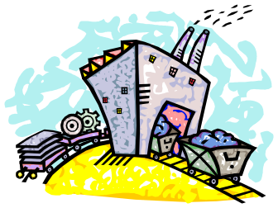




Vertical Integration
Every product has a supply chain which starts from the extraction of raw materials and involves manufacture, distribution and sales to the final customer;
Upstream
Midstream
Downstream
Raw Material
Distribution
Retail and Customers
Manufacture
EBS MBA / AUC

Slide 17
Vertical Integration
Vertical integration relates to the part of the supply chain which is controlled by a company. Every company is to some extent vertically integrated.
Forward integration occurs when a farmer becomes involved in the marketing of wool to garment manufacturers;
Backward integration occurs when manufacturers purchase farms, perhaps with the intention of ensuring the supply of certain types of wool.
The degree of vertical integration is closely bound up with the business definition of the company as discussed at 3.2.
EBS MBA / AUC

Slide 18
Vertical Integration
what is the rationale for vertical integration?
  Company should make something itself or buy it from the Market?
  Benefits and Costs of using the market rather than producing internally:
Benefits of using market forms:
Market firms can achieve economies of scale.
Market firms are subject to the discipline of the market (efficiency and control).
Costs of using market forms:
Coordination of production flows may be compromised.
Private information may be leaked to competitors.
Transaction costs may be incurred.
EBS MBA / AUC

Slide 19
Vertical Integration
  Three incorrect arguments used to justify making rather than buying:
  On the other hand, a complete contract with a market supplier cannot be achieved in the way that an internal contract can. There are at least three reasons for this.
Avoid paying the costs necessary to make the product – costs have to be borne by someone.
Avoid paying a profit margin to other firms – relative profitability is the key.
Avoid paying high prices during periods of peak demand or scarce supply - relative profitability is the key.
Impossible to cover all eventualities into account – bounded rationality
Severe difficulties involved in specifying and measuring performance with any accuracy;
Neither party is willing to reveal all information.
EBS MBA / AUC

Slide 20
Vertical Integration
‘Holdup’ problem: a party in a contractual relationship may be able to exploit the other party’s vulnerability once the contract has been agreed.
There are a number of ways by which internal organization can better resolve the holdup problem than arm’s length market contracting:
  vertical integration gives access to more powerful governance structures - disputes can be settled by internal administrative mechanisms
  internal relationship - more incentive to get things right.
  cooperation - bound together in a common purpose.
    one point of view is that the balancing of incentives for competitive and cooperative behaviors among autonomous units within a firm is the single most important task of top management.
EBS MBA / AUC

Slide 21
Vertical Integration
Conclusion:
  Make rather than buy generates some formidable principal/agent problems.
  Internal pricing system + difficulty in identifying where value is being created or destroyed.
    Some allow managers the option of buying from outside suppliers if their price is lower.
EBS MBA / AUC

Slide 22
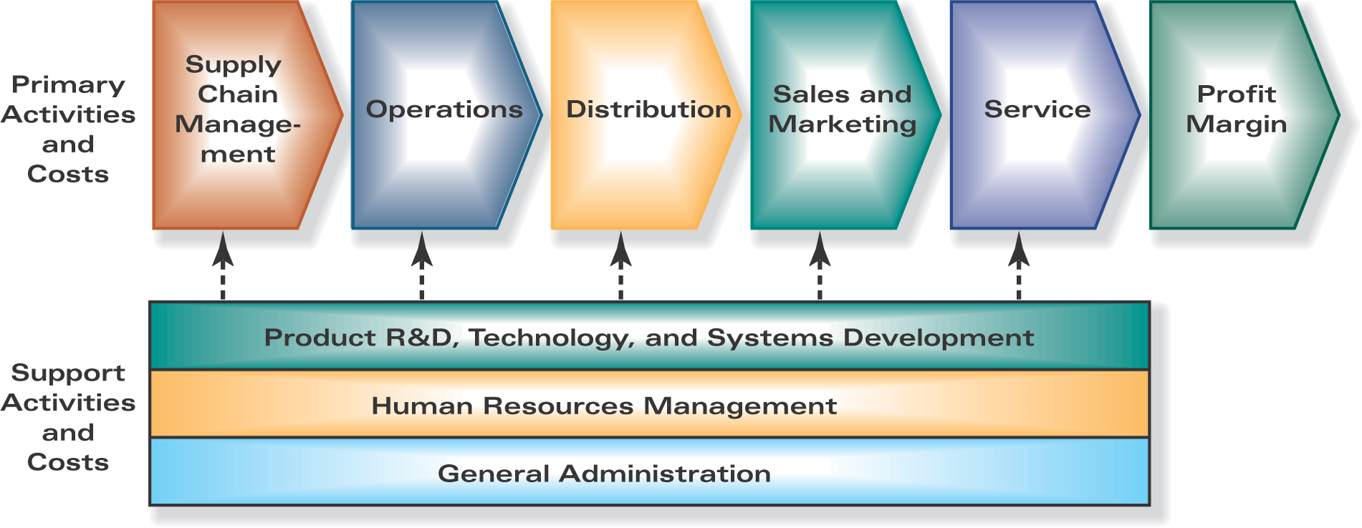
Representative Company Value Chain
EBS MBA / AUC

Slide 23
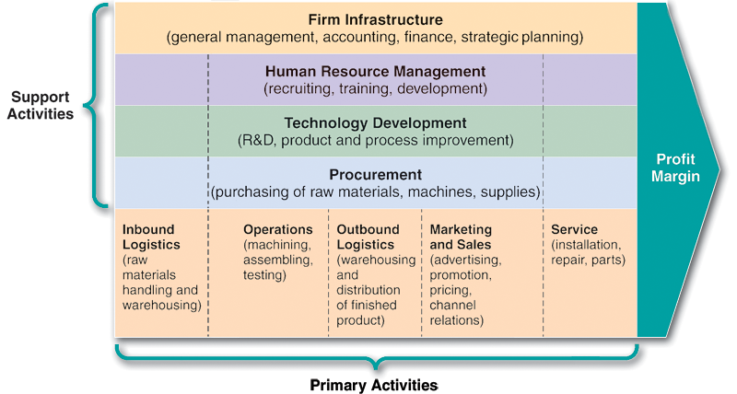
The Value Chain
A company can be visualized as a chain of value producing activities which starts with inputs at one end and sales at the other;
The overall value is represented by profitability,
EBS MBA / AUC

Slide 24
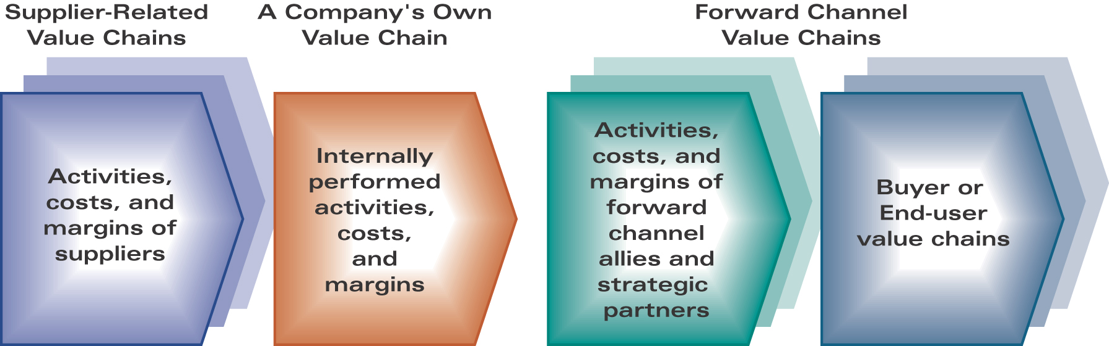
Representative Value Chain for an Entire Industry
EBS MBA / AUC

Slide 25
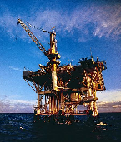
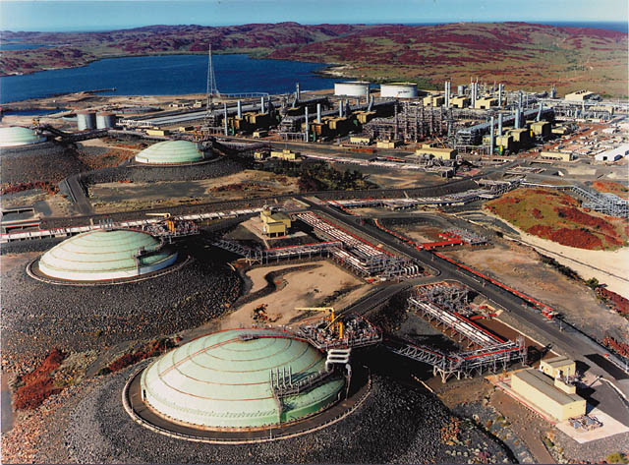
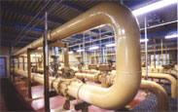
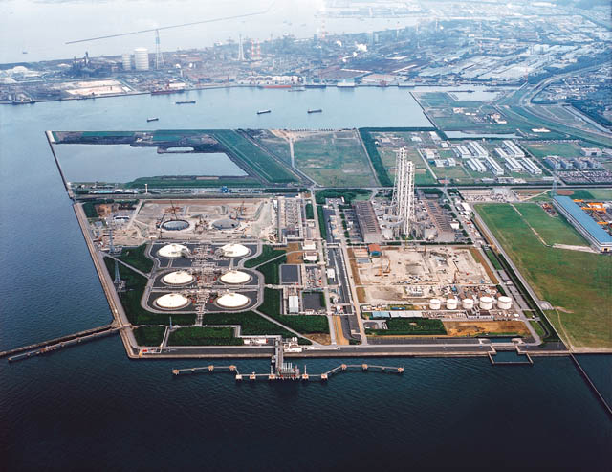
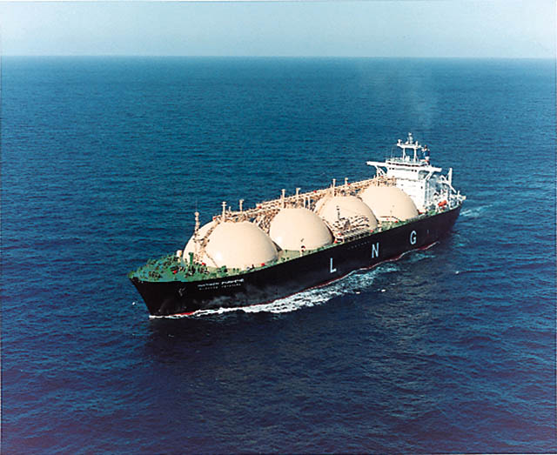
Ex. The Natural Gas Industry Chain
Upstream
Midstream
Downstream
Pipeline
Exploration & Production
Processing
User
LNG
British Gas Example:
  Vertically integrated exploration, production and distribution company
  A study demonstrated that British Gas achieves few real benefits from vertical integration.
  Breakup value was about 25 per cent higher than the corporate value.
EBS MBA / AUC

Slide 26
The Value Chain
The primary activities are:
  Inbound logistics: receiving, storing and handling inputs
  to the production process.
  Operations: transforming inputs into outputs; this is the physical process of making, testing and packaging the product.
  Outbound logistics: moving the product from operations to buyer in the case of a tangible product, and bringing the buyer to the product in the case of many services.
  Marketing and sales: providing the buyer with information, inducement and opportunities to buy the product.
  Service: maintaining the value of the product.
Each of these primary activities can be identified and analyzed to determine its contribution to the value created by the company.
But it is not just the effectiveness with which these primary activities are performed that is important, but their linkages among each other and with the following support activities.
EBS MBA / AUC

Slide 27
The Value Chain
The support activities are:
  Procurement: the process by which resources are acquired.
  Technology development: the technology associated with each of the value activities, including learning by doing, product design and process development.
  Human resource management: the whole business of managing the workforce.
  Management systems: including quality control, finance and operational planning.
EBS MBA / AUC

Slide 28
The Value Chain
The notion of value in value chain analysis is how the ultimate user views the product in relation to competitive products.
The objective is to identify distinctive competencies (compared with competitors) which generate competitive advantage;
An understanding of the value chain is important for identifying strategic options as it helps to provide an overview of the strengths and weaknesses of the company in a competitive setting.
Simply disaggregating the activities of the company into a chain and analyzing the components may not tell the whole story, as it may be the linkages between value activities which contribute to competitive advantage.
  almost impossible to replicate the linkages among the components because these are unique to the company.
  Marks & Spencer ex. almost impossible for other retailers to imitate the its linkages
  Dispersion of value chain to exploit different national environments (e.g. Nike conducts R&D in US, components in Korea and Thailand, assembly in Indonesia, China, and India, marketing in Europe and North America) – Diamond Model
EBS MBA / AUC

Slide 29
Competence
Different companies are relatively good at different things at different times.
The aspects of competitive performance which a company is relatively good at are its capabilities, or competencies.
The key is the integration of competencies into a value generating chain.
Necessary for individual competencies to be better than those of competitors, and to have the competencies combined in such a way that the resulting organisation cannot be readily imitated.
Core competencies can be viewed as the pool of experience, knowledge and systems etc. that exist in the corporation as a whole.
EBS MBA / AUC

Slide 30
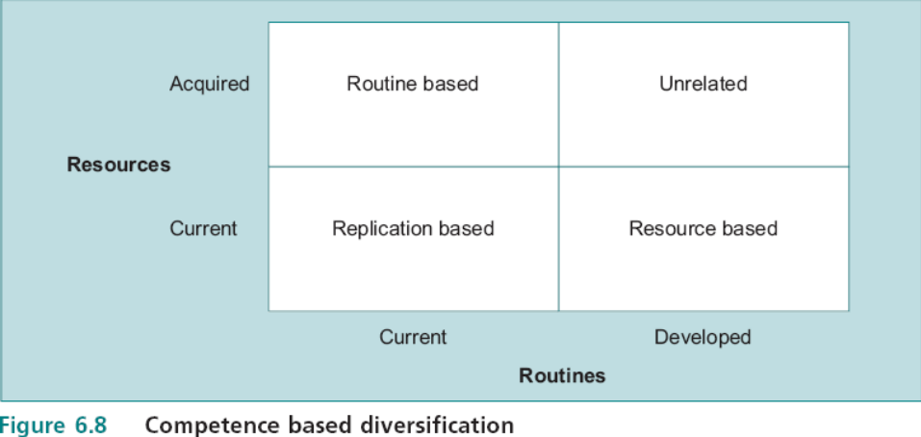
Competence
Routine-based Diversification: same
competences (or routines) were relevant for the management of different types of
Utility - existing systems and distinctive capabilities.
Ex. ScottishPower: from electricity utility
company into water, gas and telecommunications.
Resource-based Diversification: same resources were the capabilities of a strong team of core business academics. New routines included self-contained teaching packages, self assessment and the use of sophisticated examinations to measure performance.
Ex. EBS distance learning MBA: from conventional learning into long-distance.
Routines: distinctive capabilities
Resources: core inputs
EBS MBA / AUC

Slide 31
Competence
Routine Based Diversification
Resource Based Diversification
Replication Based Diversification
Unrelated Diversification
Diversification Trajectory
EBS MBA / AUC

Slide 32
Strategic Architecture
The way in which the company’s collection of unique attributes is combined together is known as strategic architecture.
It is a network of relational contracts within or around the firm.
  Firms establish relationships with their employees (internal architecture),
  with their suppliers or customers (external architecture),
  or among a group of firms engaged in related activities (networks).
Strategic architecture is unique to every company;
EBS MBA / AUC

Slide 33
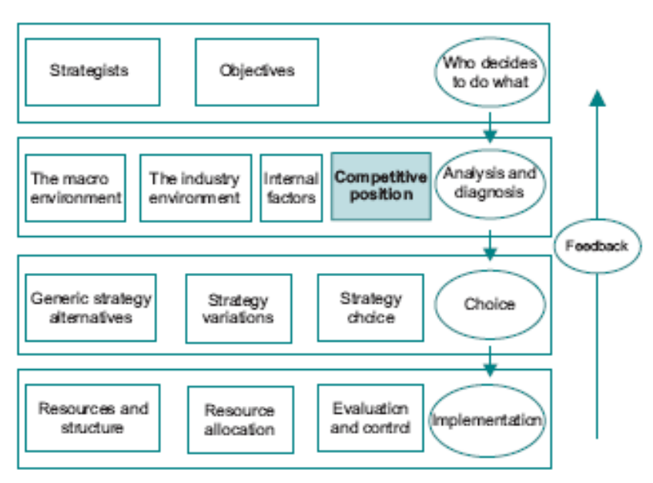
The Definition of Competitive Advantage
EBS MBA / AUC

Slide 34
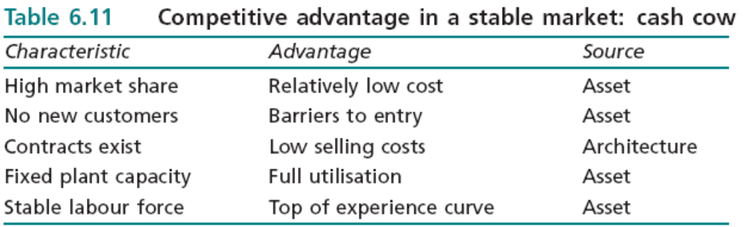
The Definition of Competitive Advantage
EBS MBA / AUC

Slide 35
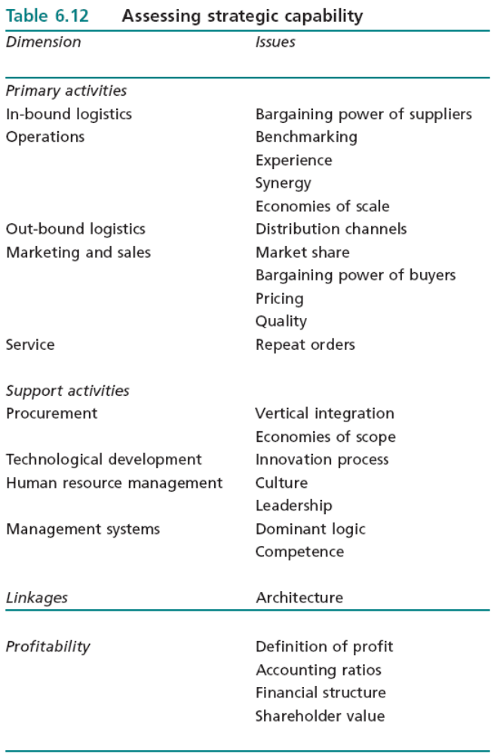
The Definition of Competitive Advantage
EBS MBA / AUC

Slide 36
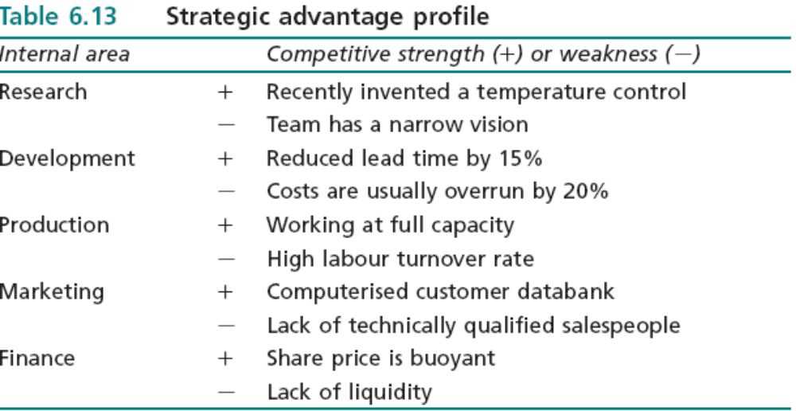
Strategic Advantage Profile
EBS MBA / AUC

